Slide 1
Unit III Regular Expressions
Prepared By:
Ghanashyam BK

Slide 2
Regular Expressions
those algebraic expressions used for representing regular languages, the languages accepted by finite automaton.
offer a declarative way to express the strings we want to accept.
Many system uses regular expression as input language.
Search commands such as UNIX grep
Lexical analyzer generator such as LEX or FLEX.
Lexical analyzer is a component of compiler that breaks the source program into logical unit called tokens.

Slide 3
Regular Expressions
Each regular expression ‘r’ denotes a language L(r)
The defining rules specify how L(r) is formed by combining in various ways
Method:
Let Σ be an alphabet, the regular expression over the alphabet Σ are defined inductively as follows:
Basic steps:
Φ is a regular expression representing empty language.
Є is a regular expression representing the language of empty strings. i.e.{Є}
if ‘a’ is a symbol in Σ, then ‘a’ is a regular expression representing the language {a}.

Slide 4
Regular Expressions
following operations over basic regular expression define the complex regular expression as:
-if ‘r’ and ‘s’ are the regular expressions representing the language L(r) and L(s) then
r U s is a regular expression denoting the language L(r) U L(s).
r.s is a regular expression denoting the language L(r).L(s).
r* is a regular expression denoting the language (L(r))*.
(r) is a regular expression denoting the language (L(r)).
Note: any expression obtained from Φ, Є, a using above operation and parenthesis where required is a regular expression.

Slide 5
Regular Operators
Basically, there are three operators that are used to generate the languages that are regular
Union (U / | /+): If L1 and L2 are any two regular languages then
L1UL2 ={s | s ε L1, or s ε L2 }
For Example:
L1 = {00, 11}, L2 = (Є, 10} then
L1UL2 = {Є, 00, 11, 10}

Slide 6
Regular Operators
Concatenation (.):
If L1 and L2 are any two regular languages then,
L1.L2 = {l1.l2|l1 ε L1 and l2 ε L2}
For examples:
L1 = {00, 11} and L2 = {Є, 10} then
L1.L2={00,11,0010,1110}
L2.L1={1000,1011,00,11}
So L1.L2 !=L2.L1

Slide 7
Regular Operators
Kleen Closure (*):
If L is any regular Language then,
L* = Li =L0 UL1UL2U………….
Precedence of regular operator:
The star operator is of highest precedence. i.e it applies to its left well formed RE.
Next precedence is taken by concatenation operator.
Finally, unions are taken

Slide 8
Regular Languages
Let Σ be an alphabet, the class of regular language over Σ is defined inductively as:
Φ is a regular language representing empty language
{Є} is a regular language representing language of empty strings.
For each a ε Σ, {a} is a regular language.
If L1, L2…………. Ln is regular languages, then so is L1U L2U………..ULn.
If LI,L2,L3,…………..Ln are regular languages, then so is L1.L2.L3………Ln
If L is a regular language, then so is L*

Slide 9
Applications of Regular Languages
Validation:
Determining that a string complies with a set of formatting constraints. Like email address validation, password validation etc.
Search and Selection:
Identifying a subset of items from a larger set on the basis of a pattern match.
Tokenization:
Converting a sequence of characters into words, tokens (like keywords, identifiers) for later interpretation.

Slide 10
Algebraic Rules for Regular Expressions
Commutativity:
Commutative of operator means we can switch the order of its operands and get the same result.
The union of regular expression is commutative but concatenation of regular expression is not commutative.
Associativity:
The unions as well as concatenation of regular expressions are associative.
i.e. if t, r, s are regular expressions representing regular languages L(t),L(r) and L(s) then,
t+(r+s) = (t+r)+s and t.(r.s) = (t.r).s

Slide 11
Algebraic Rules for Regular Expressions
Distributive law:
For any regular expression r,s,t representing regular language L(r), L(s) and L(t) then,
r(s+t) = rs+rt ------ left distribution.
(s+t)r = sr+tr ------ right distribution
Identity law:
Φ is identity for union. i.e. for any regular expression r representing regular expression L(r).
r + Φ = Φ + r = r i.e. Φ U r = r.
Є is identity for concatenation. i.e. Є.r = r = r. Є

Slide 12
Algebraic Rules for Regular Expressions
Annihilator:
An annihilator for an operator is a value such that when the operator is applied to the annihilator and some other value, the result is annihilator.
Φ is annihilator for concatenation.
i.e. Φ.r = r.Φ = Φ
Idempotent law of union:
For any regular expression r representing the regular language L(r), r + r = r.
This is the idempotent law of union.

Slide 13
Algebraic Rules for Regular Expressions
Law of closure:
for any regular expression r, representing the regular language L(r),then
(r*)*=r*
Closure of Φ = Φ* = Є
Closure of Є = Є* = Є
Positive closure of r, r+ = rr*.

Slide 14
Regular Expressions Examples
Consider Σ = {0, 1}, then some regular expressions over Σ are:
0*10* is RE that represents language {w|w contains a single 1}
Σ * 1Σ* is RE for language{w|w contains at least single 1}
Σ*001 Σ* = {w|w contains the string 001 as substring}
(Σ Σ)* or ((0+1)*.(0+1)*) is RE for {w|w is string of even length}
1*(01*01*)* is RE for {w|w is string containing even number of zeros}

Slide 15
Regular Expressions Examples
0*10*10*10* is RE for {w|w is a string with exactly three 1’s}
For string that have substring either 001 or 100, the regular expression is (1+0)*.001.(1+0)*+(1+0)*.(100).(1+0)*
For strings that have at most two 0’s with in it, the regular expression is 1*.(0+Є).1*.(0+Є).1*
For the strings ending with 11, the regular expression is (1+0)*.(11)

Slide 16
Finite Automata and Regular expression
In order to show that the RE define the same class of language as Finite automata, we must show that:
Any language define by one of these finite automata is also defined by RE.
Every language defined by RE is also defined by any of these finite automata.

Slide 17
Reduction of Regular Expression to ε – NFA
We can show that every language L(R) for some RE R, is also a language L(E) for some epsilon NFA.
This say that both RE and epsilon-NFA are equivalent in terms of language representation.
Theorem 1
For any regular expression r, there is an Є-NFA that accepts the same language represented by r.
Proof:
Let L =L(r) be the language for regular expression r, now we have to show there is an Є-NFA E such that L (E) =L.

Slide 18
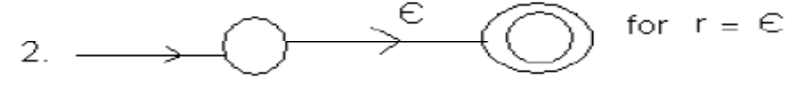
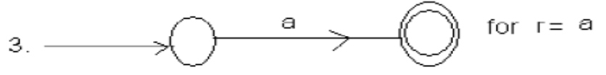
Reduction of Regular Expression to ε – NFA
The proof can be done through structural induction on r, following the recursive definition of regular expressions.
For this we know Φ, Є, ‘a’ are the regular expressions representing languages {Φ}; an empty language, {Є};language for empty strings and {a} respectively.
The Є-NFA accepting these languages can be constructed as;
This Forms the basic steps

Slide 19
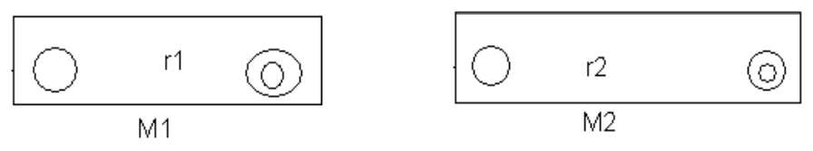
Reduction of Regular Expression to ε – NFA
Now the induction parts are shown below
Let r be a regular expression representing language L(r) and r1,r2 be regular expressions for languages L(r1) and L(r2),
For union ‘+’: From basis step we can construct Є-NFA’s for r1 and r2. Let the Є-NFA’s be M1 and M2 respectively

Slide 20
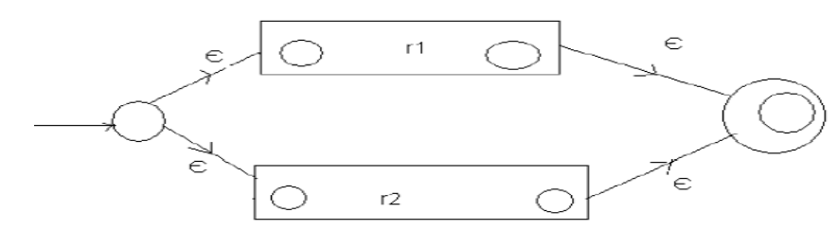
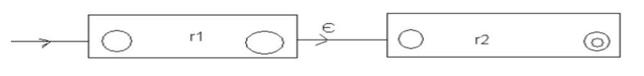
Reduction of Regular Expression to ε – NFA
Then, r=r1+r2 can be constructed as:
The language of this automaton is L(r1) U L(r2) which is also the language represented by expression r1+r2.
For concatenation ‘.’ : Now, r = r1.r2 can be constructed as;

Slide 21
Reduction of Regular Expression to ε – NFA
Here, the path from starting to accepting state go first through the automaton for r1, where it must follow a path labeled by a string in L(r1), and
then through the automaton for r2, where it follows a path labeled by a string in L(r2).
Thus, the language accepted by above automaton is L(r1).L(r2).

Slide 22
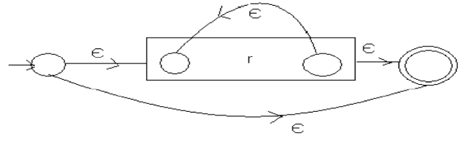
Reduction of Regular Expression to ε – NFA
For *(Kleen closure)
Now, r* Can be constructed as;
Clearly language of this Є-NFA is L(r*) as it can also just Є as well as string in L(r), L(r)L(r), L(r)L(r)L(r) and so on. Thus covering all strings in L(r*).
This completes the proof.

Slide 23
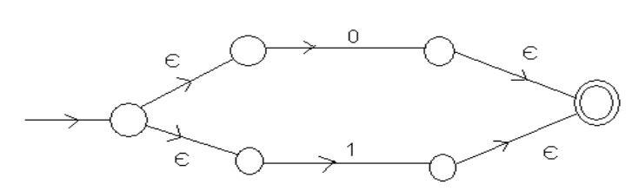
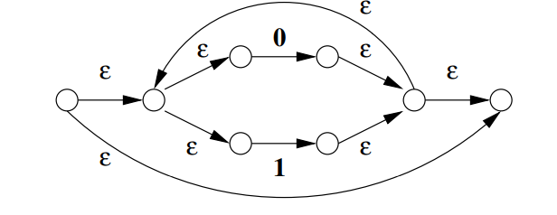
Examples (Conversion from RE to Є-NFA)
For regular expression (1+0) the Є-NFA is:
for (0+1)*, the Є-NFA is:

Slide 24
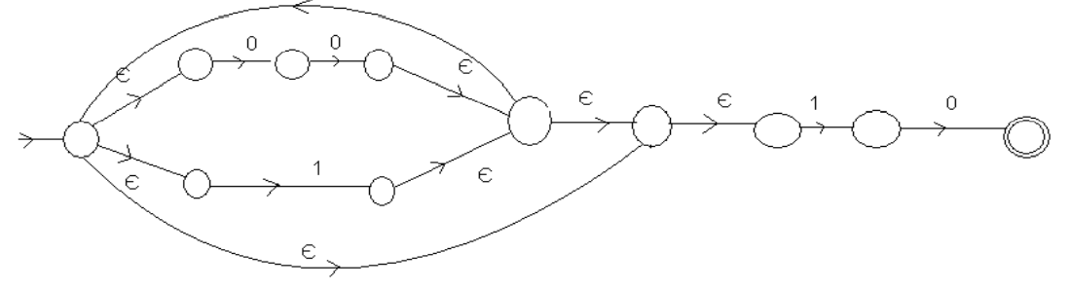
Examples (Conversion from RE to Є-NFA)
For regular expression (00+1)*10 the Є-NFA is as:
Now,Find Є-NFA for whole regular expression (0+1)*1(0+1)

Slide 25
Equivalence of Regular Expression and Finite Automata
Discussed in class.

Slide 26
Conversion of DFA to Regular Expression
Arden’s Theorem:
Let p and q be the regular expressions over the alphabet Σ, if p does not contain any empty string then r = q + rp has a unique solution r = qp*.
Proof:
Here, r = q + rp ……………… (i)
Let us put the value of r = q + rp on the right hand side of the relation (i), so;
r = q + (q + rp)p
r = q + qp + rp2………………(ii)

Slide 27
Conversion of DFA to Regular Expression
Again putting value of r = q + rp in relation (ii), we get;
r = q + qp + (q +rp) p2
r = q+ qp + qp2 + rp3………………
Continuing in the same way, we will get as;
r = q + qp + qp2 + qp3………………..
r = q(Є + p + p2 +p3 +…………………..
Thus r = qp* Proved.

Slide 28
Conversion of DFA to Regular Expression
Use of Arden’s rule to find the regular expression for DFA:
To convert the given DFA into a regular expression, here are some of the assumptions regarding the transition system:
The transition diagram should not have the Є-transitions.
There must be only one initial state.
The vertices or the states in the DFA are as;
q₁,q₂,……………..q_{n} (Any q_{i} is final state)

Slide 29
Conversion of DFA to Regular Expression
W_{ij} denotes the regular expression representing the set of labels of the edjes from q_{i} to q_{j}.
Thus we can write expressions as;
q₁=q₁w₁₁+q₂w₂₁+q₃w₃₁+………………q_{n}w_{n1}+Є q₂=q₁w₁₂+q₂w₂₂+q₃w₃₂+………………+q_{n}w_{n2} q₃=q₁w₁₃+q₂w₂₃+q₃w₃₃+………………+q_{n}w_{n3} ………………………………………………… ………………………………………………… q_{n}=q₁w_{1n}+q₂w_{n2}+q₃w_{n3}+………………………q_{n}w_{nn}
Solving these equations for qi in terms of wij gives the regular expression eqivalent to given DFA.

Slide 30
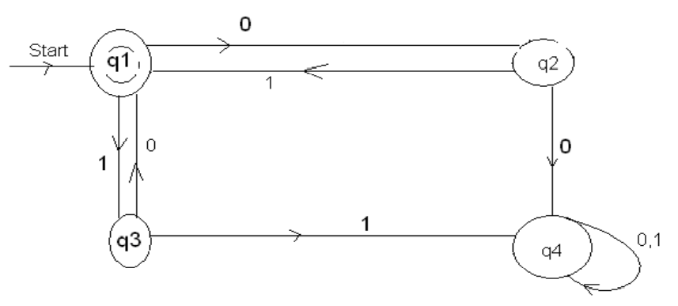
Conversion of DFA to Regular Expression
Examples: Convert the following DFA into regular expression.
Let the equations are:
q₁= Є + q₂1+q₃0……….(i)
q₂=q₁0…………………(ii)
q₃=q₁1…………………..(iii)
q₄=q₂0+q₃1+q₄0+ q₄1……(iv

Slide 31
Conversion of DFA to Regular Expression
Putting the values of q2 and q3 in (i)
q₁=q₁01+q₁10+ Є
i.e.q₁=q₁(01+10)+ Є
i.e.q₁= Є+q₁(01+10) (since r = q+rp)
i.e. q₁= Є(01+10)* (using Arden’s rule)
Since, q1 is final state, the final regular expression for the DFA is
Є(01+10)*
= (01+10)*

Slide 32
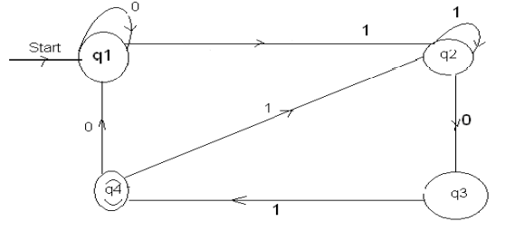
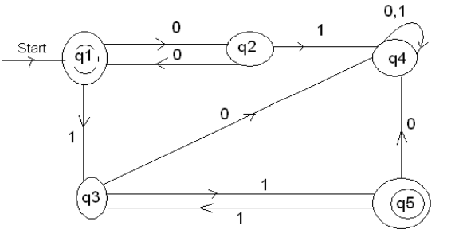
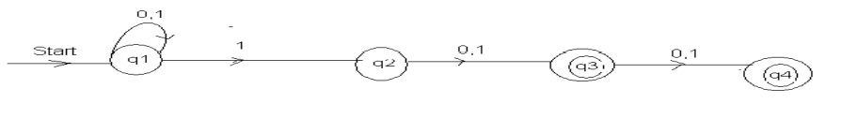
Excercises
Convert the following DFA into RE.

Slide 33
Representation of Languages
Representations can be formal or informal.
Example (formal): represent a language by a RE or DFA defining it.
Example: (informal): a logical or prose statement about its strings:
{0n1n | n is a nonnegative integer}
The set of strings consisting of some number of 0’s followed by the same number of 1’s.

Slide 34
Properties of Regular Languages
Language classes have two important kinds of properties:
Decision properties.
A decision property for a class of languages is an algorithm that takes a formal description of a language (e.g., a DFA) and tells whether or not some property holds.
Example: Is language L empty?
Closure properties.
A closure property of a language class says that given languages in the class, an operator (e.g., union) produces another language in the same class.
Example: the regular languages are obviously closed under union, concatenation, and (Kleene) closure.Use the RE representation of languages.

Slide 35
Pumping Lemma
It is shown that the class of language known as regular language has at least four different descriptions.
They are the language accepted by DFA‟s, by NFA‟s, by Є-NFA, and defined by RE.
Not every language is Regular.
To show that a langauge is not regular, the powerfull technique used is known as Pumping Lemma.

Slide 36
Pumping Lemma
Statement:
Let L be a regular language. Then, there exists an integer constant n so that for any x ε L with |x| ≥ n, there are strings u, v, w such that x = uvw,
v is not equal to Є
|uv| ≤ n,
|v| > 0.
Then uv^{k}w ε L for all k ≥ 0.
Note: Here k is the string that can be pumped i.e repeating k any number of times or deleting it, keeps the resulting string in the language.

Slide 37
Pumping Lemma
Proof:
Suppose L is a regular language, then L is accepted by some DFA M. Let M has n states. Also L is infinite so M accepts some string x of length n or greater. Let length of x, |x| =m where m ≥ n.
Now suppose;
X = a₁a₂a₃………………a_{m} where each a_{i} ε Σ be an input symbol to M. Now, consider for j = 1,………….n, q_{j} be states of M

Slide 38
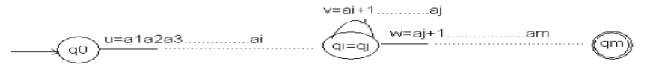
Pumping Lemma
Then,
(q₀,x) = (q₀,a₁a₂………..a_{m}) [q₀ being start state of M]
= (q₁,a₂………a_{m})
=…………………
=…………………
= (q_{m},Є) [q_{m} being final state]
Since m ≥ n, and DFA M has only n states, so by pigeonhole principle, there exists some i and j; 0 ≤ i < j ≤ m such that q_{i} =q_{j}.

Slide 39
Pumping Lemma
Now we can break x=uvw as
u = a₁a₂…………..a_{i}
v =a_{i}+1……………a_{j}
w =a_{j}+1……………a_{m}
i.e. string a_{i}+1 ………………a_{j} takes M from state q_{i} back to itself since q_{i} = q_{j}. So we can say M accepts a₁a₂…………a_{i}(a_{i}+1…………a_{j})^{k} a_{j}+1……………a_{m} for all k≥0.
Hence, uv^{k}w ε L for all k≥0.

Slide 40
Application of Pumping Lemma
To prove any language is not a regular language.
For example: Show that language, L={0r1r|r ≥0} is not a regular language.
Solution:
Let L is a regular language. Then by pumping lemma, there are strings u, v, w with v≥1 such that uv^{k}w ε L for k≥0.

Slide 41
Application of Pumping Lemma
Case I:
Let v contain 0’s only. Then,
suppose u = 0^{p} , v = 0^{q} ,w = 0^{r}1^{s} ;
Then we must have p+q+r = s (as we have 0^{r}1^{r} ) and q>0
Now, uv^{k}w = 0^{p}(0^{q})^{k}0^{r}1^{s} = 0^{p+qk+r}1^{s}
Only these strings in 0^{p+qk+r}1^{s} belongs to L for k=1 otherwise not.
Hence we conclude that the language is not regular.

Slide 42
Application of Pumping Lemma
Case II
Let v contains 1’s only. Then u= 0^{p}1^{q} , v = 1^{r} , w=1^{s}
Then p= q+r+s and r>0
Now, 0^{p}1^{q}(1^{r})^{k}1^{s} = 0^{p}1^{q+rk+s}
Only those strings in 0^{p}1^{q+rk+s} belongs to L for k =1 otherwise not.
Hence the language is not regular.

Slide 43
Application of Pumping Lemma
Case III
V contains 0’s and 1’s both. Then, suppose,
u = 0^{p} , v = 0^{q}1^{r} , w = 1^{s} ;
p+q = r+s and q+r>0
Now, uv^{k}w = 0^{p}(0^{q}1^{r})^{k}1^{s} = 0^{p+qk}1^{rk+s}
Only those strings in 0^{p+qk}1^{rk+s} belongs to L for k=1, otherwise not. (As it contains 0 after 1 for k>1 in the string.)
Hence the language is not regular.

Slide 44
Closure Properties of Regular Languages
The union of two regular languages is regular
The intersection of two regular languages is regular.
The complement of a regular language is regular
The difference of two regular language is regular.
The reversal of a regular language is regular.
The closure (star) of a regular language is regular.
The concatenation of a regular language is a regular.

Slide 45
Properties of Regular Languages over Union(U)
Theorem: If L and M are regular languages, then so is L U M.
Proof:
Since, L and M are regular, they have regular expressions,
Say L=L(R) and M = L(S). Then
L U M = L(R+S) by the definition of the + operator for regular expressions.

Slide 46
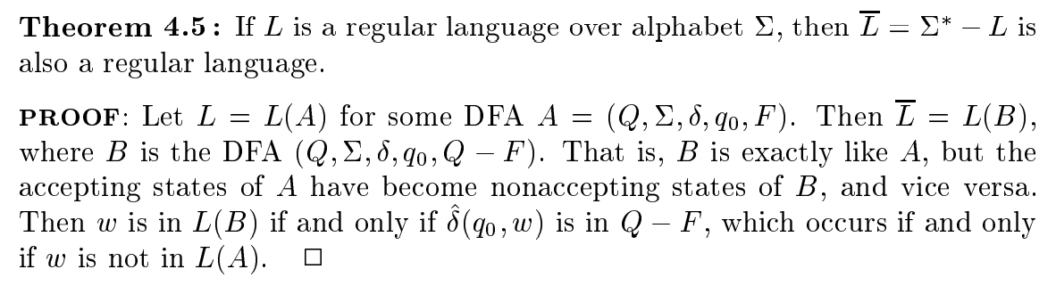
Properties of Regular Languages over Complement

Slide 47
Minimization of Finite State Machines: Table Filling Algorithm
Given a DFA M, that accepts a language L (M). Now, configure a DFA M’. During the course of minimization, it involves identifying the equivalent states and distinguishable states.
Equivalent States: Two states p & q are called equivalent states, denoted by p ≡ q if and only if for each input string x, ( (p, x) is a final state if and only if (q, x) is a final state.
Distinguishable state: Two states p & q are said to be distinguishable states if (for any) there exists a string x, such that (p, x) is a final state (q, x) is not a final state.

Slide 48
Minimization of Finite State Machines: Table Filling Algorithm
The steps of the algorithm are; For identifying the pairs (p, q) with p ≠ q;
List all the pairs of states for which p ≠ q.
Make a sequence of passes through each pairs.
On first pass, mark the pair for which exactly one element is final (F).
On each sequence of pass, mark the pair (r, s) if for any a ε Σ, δ(r, a) = p and δ(s, a) = q and (p, q) is already marked.
After a pass in which no new pairs are to be marked, stop
Then marked pairs (p, q) are those for which p and q are not equivalent and unmarked pairs are those for which p ≡ q.

Slide 49
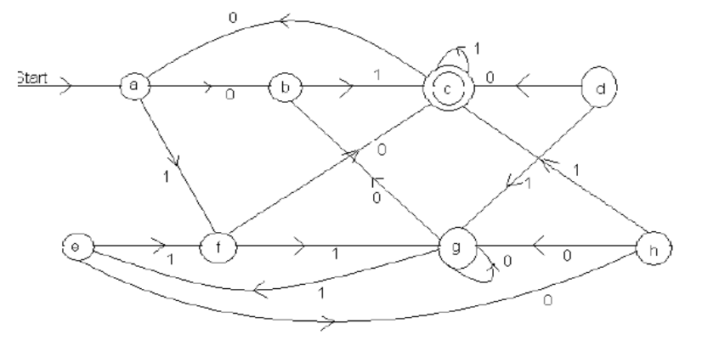
Minimization of Finite State Machines: Table Filling Algorithm
Example

Slide 50
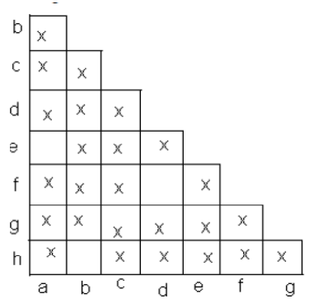
Minimization of Finite State Machines: Table Filling Algorithm
Now to solve this problem first we should determine weather the pair is distinguishable or not.

Slide 51
Minimization of Finite State Machines: Table Filling Algorithm
For pair (b, a)
(δ(b, 0 ), δ(a, 0)) = (g, h) – unmarked
(δ(b, 1), δ(a, 1)) = (c, f) – marked
For pair (d, a)
(δ(d, 0), δ(a, 0)) = (c, b) – marked
Therefore (d, a) is distinguishable.
For pair (e, a)
(δ(e, 0), δ(a, 0)) = (h, h) – unmarked.
(δ(e, 1), δ(a, 1)) = (f, f) –unmarked.
[(e, a) is not distinguishable)]

Slide 52
Minimization of Finite State Machines: Table Filling Algorithm
For pair (g, a)
(δ(g, 0), δ( a, 0)) = (a, g) – unmarked.
(δ(g, 1), δ(a, 1)) = (e, f) – unmarked
For pair (h, a)
(δ(h, 0), δ(a, 0)) = (g, h) –unmarked
(δ(h, 1), δ(a 1) = (c, f) – marked
Therefore (h, a) is distinguishable.
For pair (d, b)
(δ(d, 0), δ(b,0)) = (c, g) – marked
Therefore (d, b) is distinguishable.

Slide 53
Minimization of Finite State Machines: Table Filling Algorithm
For pair (e, b)
(δ(e, 0), δ(b,0)) = (h, g) –unmarked
(δ(e, 1), δ(b,1) = (f, c) – marked.
For pair (f, b)
(δ(f, 0), δ(b,0)) = (c, g) – marked
For pair (g, b)
(δ(g, 0), δ(b, 0)) = (g, g) – unmarked
(δ(h, 1), δ(b, 1)) = (e, c) – marked
For pair (h, b)
(δ(h, 0), δ(b, 0)) = (g, g) – unmarked
(δ(h,1), δ(b,1)) = (c, c) - unmarked.

Slide 54
Minimization of Finite State Machines: Table Filling Algorithm
For pair (e, d)
(δ(e, 0), δ(d, 0)) = (h, c) – marked
(e, d) is distinguishable.
For pair (f, d)
(δ(f, 0), δ(d, 0)) = (c, c) – unmarked
(δ(f,1), δ(f,1)) = (g, g) - unmarked.
For pair (g, d)
(δ(g, 0), δ(d, 0)) = (g, c) – marked
For pair (h, d)
(δ(h, 0), δ(d, 0)) = (g, c) – marked

Slide 55
Minimization of Finite State Machines: Table Filling Algorithm
For pair (f, e)
(δ(f, 0), δ(e, 0)) = (c, h) – marked
For pair (g, e)
(δ(g, 0), δ(e, 0)) = (g, h) – unmarked
(δ(g,1), δ(e,1)) = (e, f) -marked.
For pair (h, e)
(δ(h, 0), δ(e, 0)) = (g, h) – unmarked
(δ(h,1), δ(e,1)) = (c, f) -marked.
For pair (g, f)
(δ(g, 0), δ(f, 0)) = (g, c) – marked

Slide 56
Minimization of Finite State Machines: Table Filling Algorithm
For pair (h, f)
(δ(h, 0), δ(f, 0)) = (g, c) – marked
For pair (h, g)
(δ(h, 0), δ(g, 0)) = (g, g) – unmarked
(δ(h,1), δ(g,1)) = (c, e) -marked.
Thus (a, e), (b, h) and (d, f) are equivalent pairs of states.

Slide 57
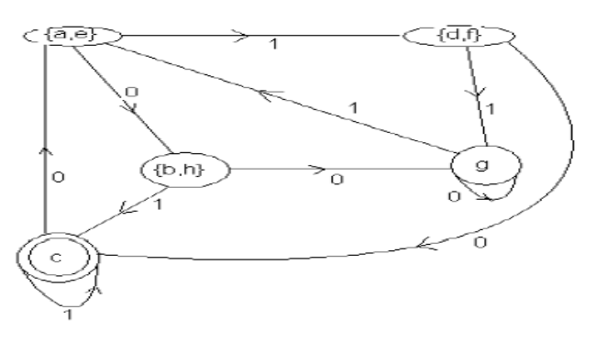
Minimization of Finite State Machines: Table Filling Algorithm
Hence the minimized DFA is

